Slide 1
Project Information
This project is focused on device simulation to help students enhance their understanding of MOSFETs and ferroelectric devices and build the skill for the commercial software (Sentaurus) which is widely used in industry for device and process simulations.

Slide 2
EE5442 Sentaurus TCAD Instruction
Lecturer: Gong Xiao elegong@nus.edu.sg
GA:
Zhang Zhilun e1143559@u.nus.edu
Sun Yiyuan e0973835@u.nus.edu
Xu Ying e0973840@u.nus.edu

Slide 3
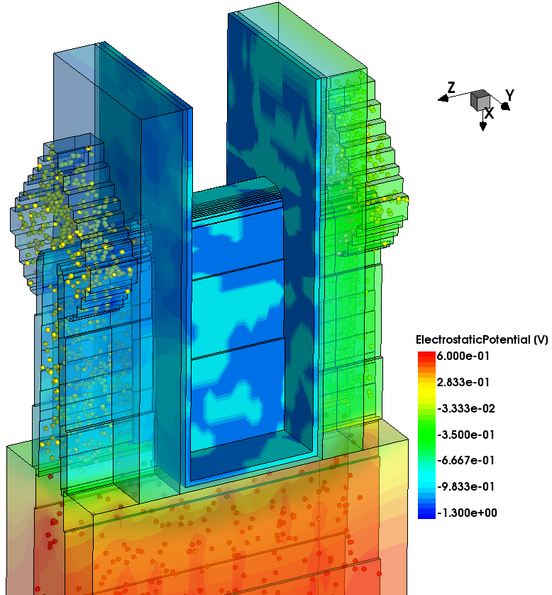
Sentaurus TCAD Introduction
Technology Computer-Aided Design (TCAD) refers to using computer simulations to develop and optimize semiconductor processing technologies and devices.
TCAD simulation tools solve fundamental, physical, partial differential equations, such as diffusion and transport equations for discretized geometries.
TCAD simulations are used widely in the semiconductor industry.

Slide 4
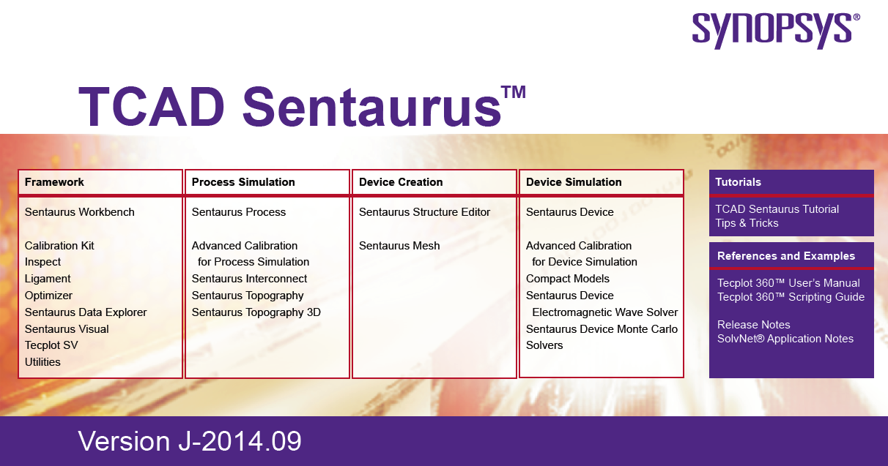
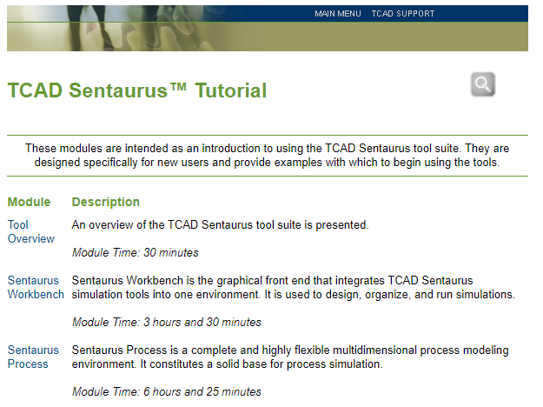
Documents for Sentaurus TCAD
More details: TCAD Sentaurus PDF Manual
TCAD Sentaurus™ Tutorial
For beginners: Website Tutorial
SDE: sense_ug.pdf
SDEVICE: sdevice_ug.pdf

Slide 5
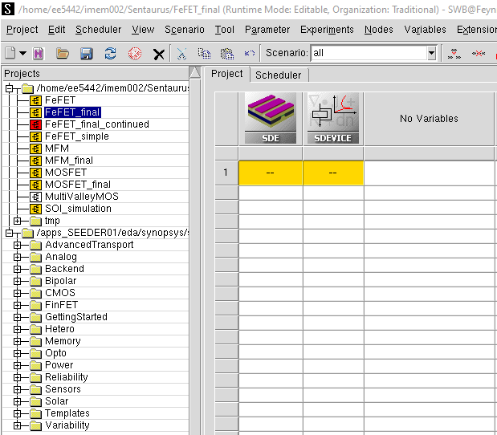
Sentaurus Workbench
The primary graphical front end that integrates TCAD Sentaurus simulation tools into one environment
To start Sentaurus Workbench: swb
Project Tree
Your projects
Examples

Slide 6
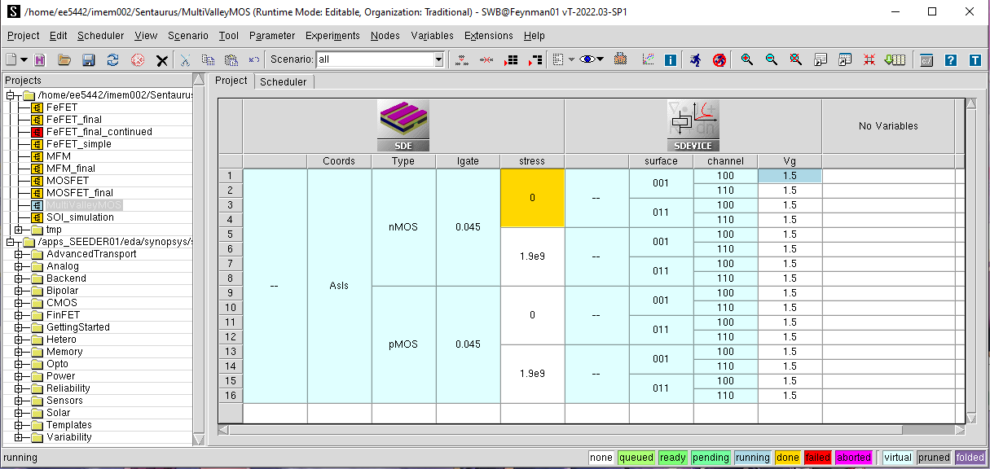
Sentaurus Workbench
Sentaurus Device
Editor (Structure)
Sentaurus Device
(Measure)
Tool flow
Parameters
Simulation nodes
Node Colors

Slide 7
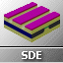
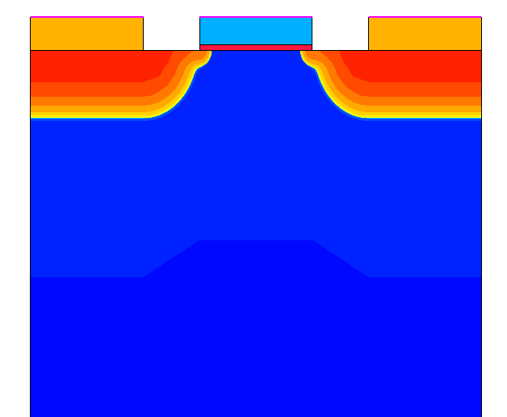
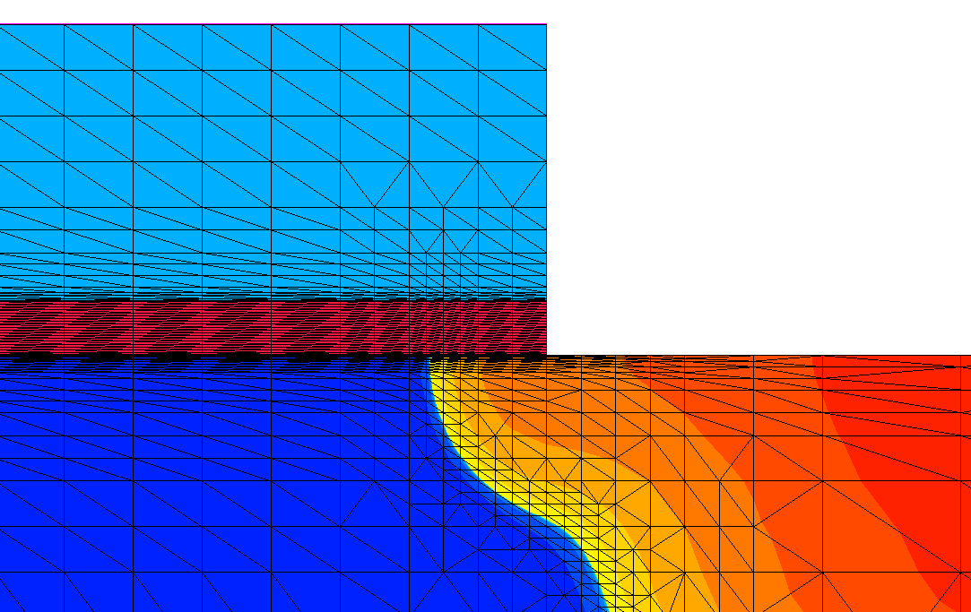
Sentaurus Structure Editor
Generate device structure
Defines electrical contact
Generates meshing for numerical simulations
Source
Gate
Drain

Slide 8
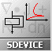
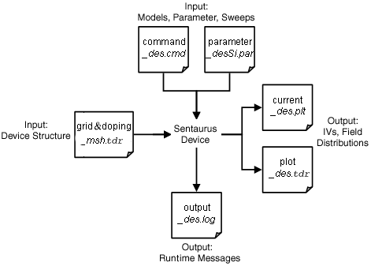
Sentaurus Device
Simulate by solving multiple, coupled physical equations based on mesh
Si band structure
Fermi-Dirac Statistics
Poisson equation
Continuity equation
Band-to-band tunneling, R-G current
Drift-Diffusion current, carrier mobility, velocity saturation
Notes:
Flow of input and output files in Sentaurus Device.

Slide 9
EE5442 Basic Operations of Sentaurus Workbench

Slide 10
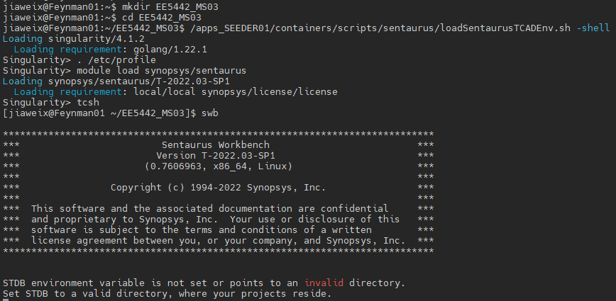
Start Sentaurus in workstations by MobaXterm
Create and go to a new folder hosting Sentaurus for this milestone
Codes to type in
mkdir your_folder
Load Sentaurus module
cd your_folder
Start Sentaurus Workbench
/apps_SEEDER01/containers/scripts/sentaurus/loadSentaurusTCADEnv.sh -shell
. /etc/profile
module load synopsys/sentaurus
tcsh
swb

Slide 11
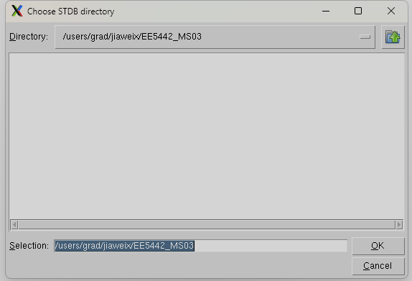
Start Sentaurus in workstations by MobaXterm

Slide 12
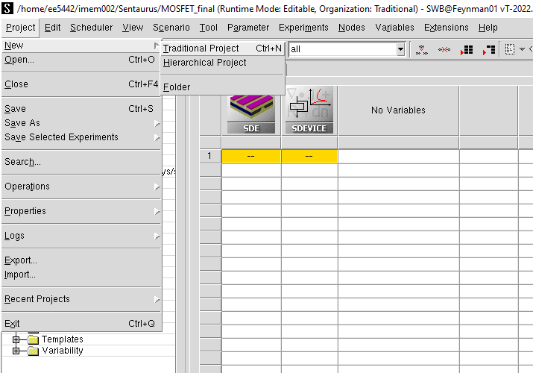
Create new project

Slide 13
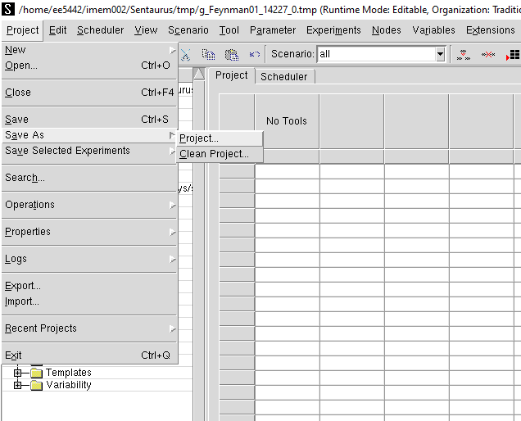
Save new project

Slide 14
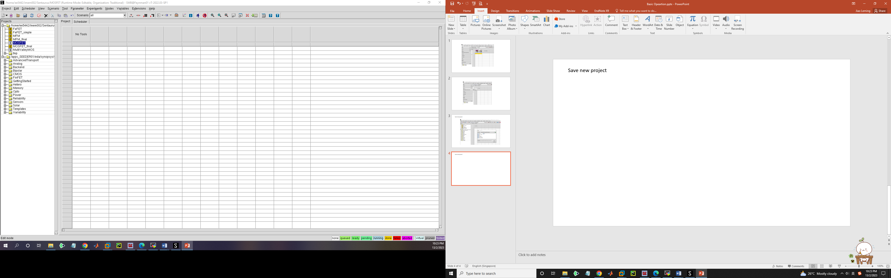
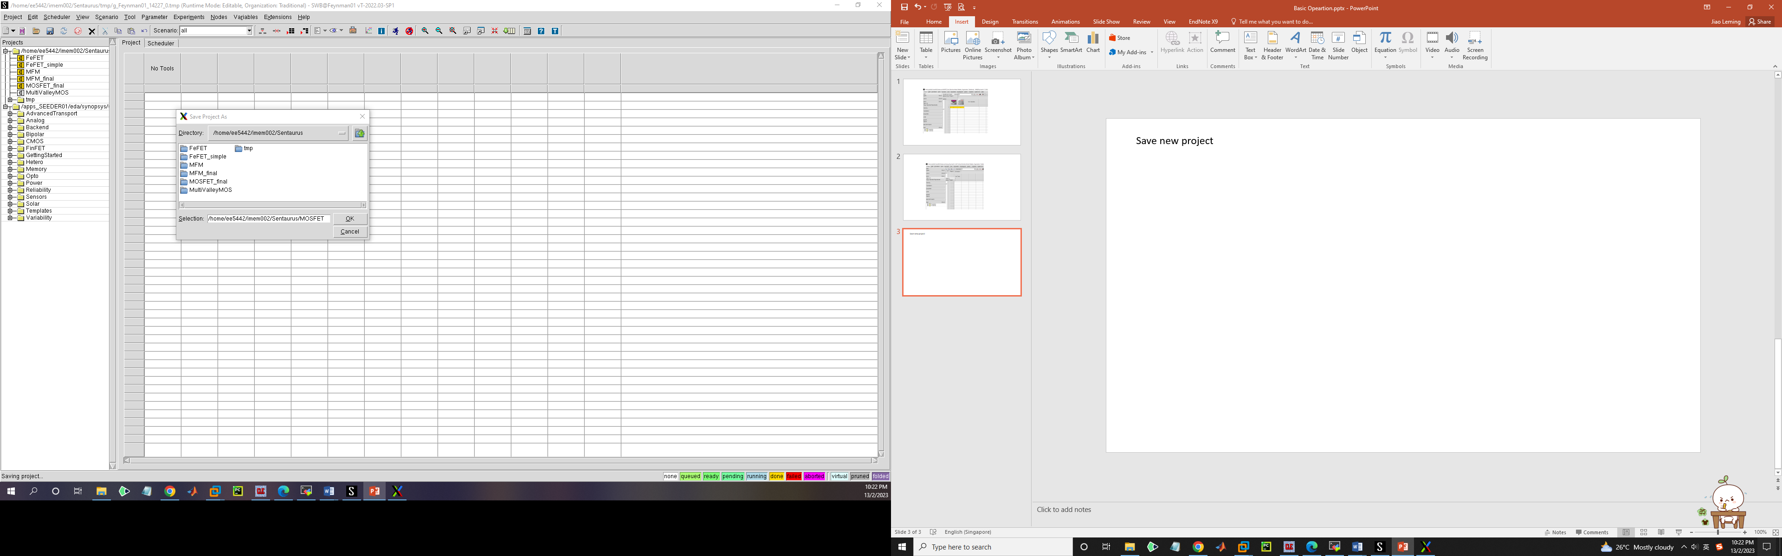
Save new project
Type in new project name in the folder you create (don’t save in ‘tmp’ !)

Slide 15
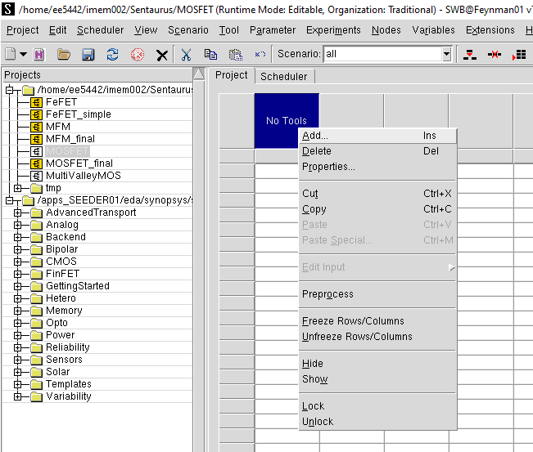
Add SDE tool for device structure design
Right click “No tools”

Slide 16
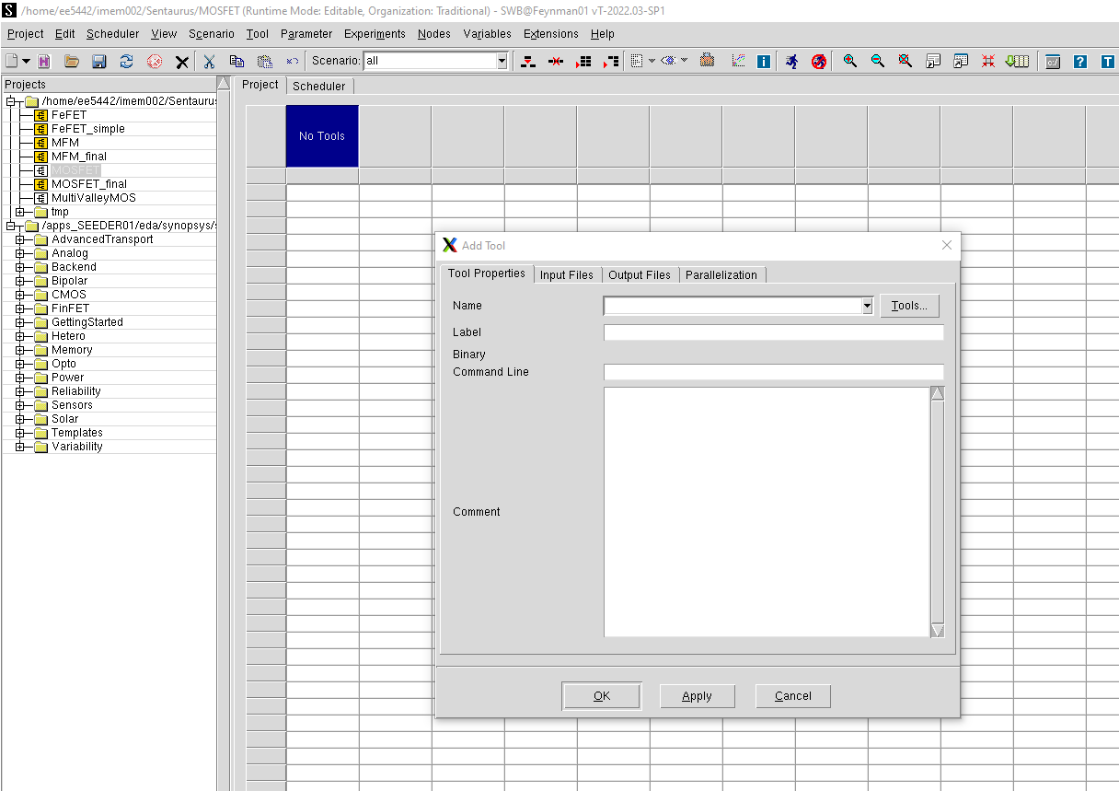
Add SDE tool for device structure design

Slide 17
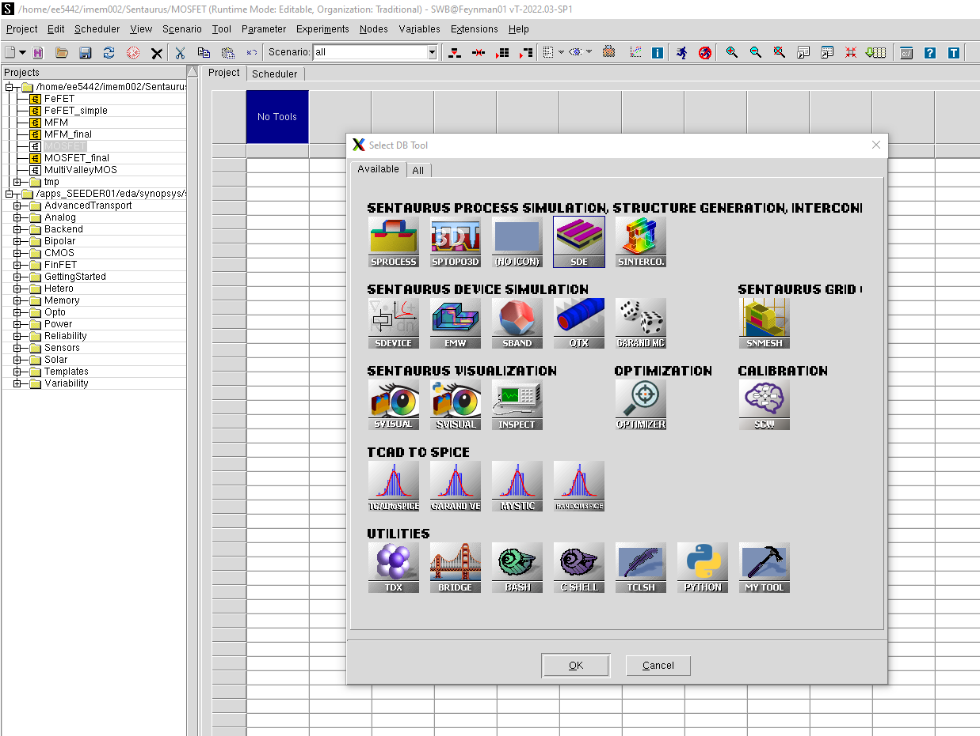
Add SDE tool for device structure design

Slide 18
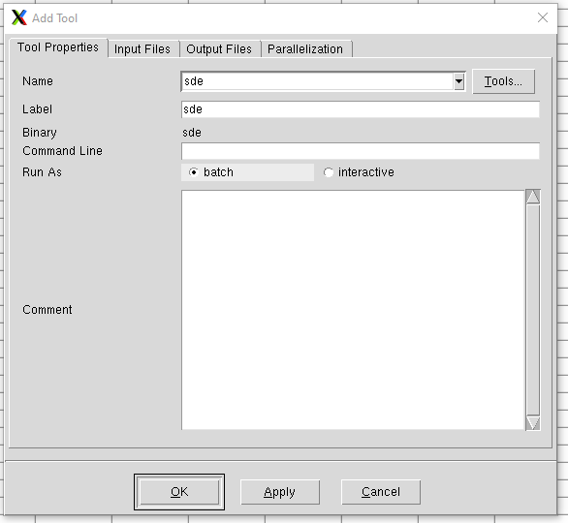
Add SDE tool for device structure design
Choose “batch”

Slide 19
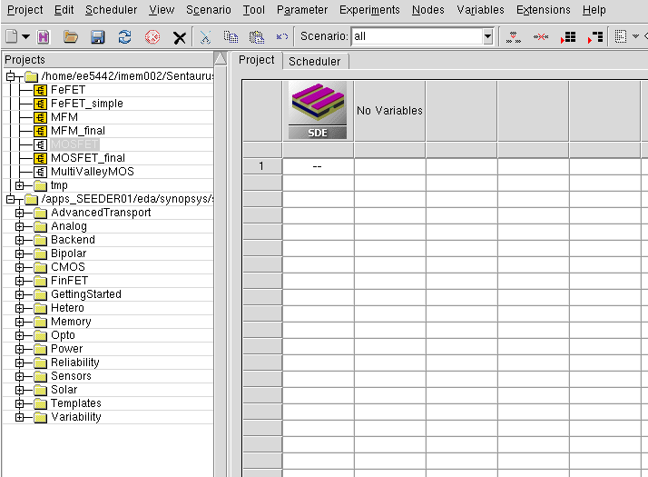
Add SDE tool for device structure design

Slide 20

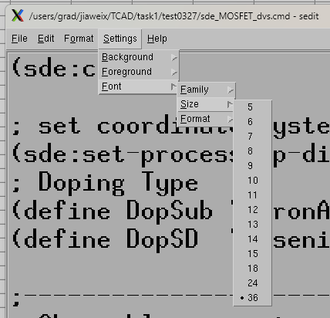
Edit sde_des.cmd for device design
Default unit in sde.cmd is “μm” and the default width of the device is 1 μm for 2-D structure
Copy code from sde_code.txt
Change font size and font family for clear show
Remember to ‘ctrl + s’ before exiting!

Slide 21
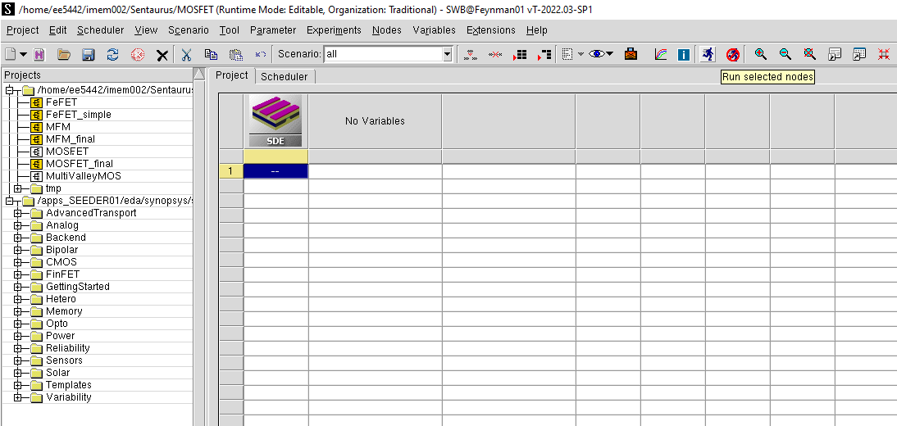
Run SDE node
Run button
Select the node/nodes you want to run

Slide 22
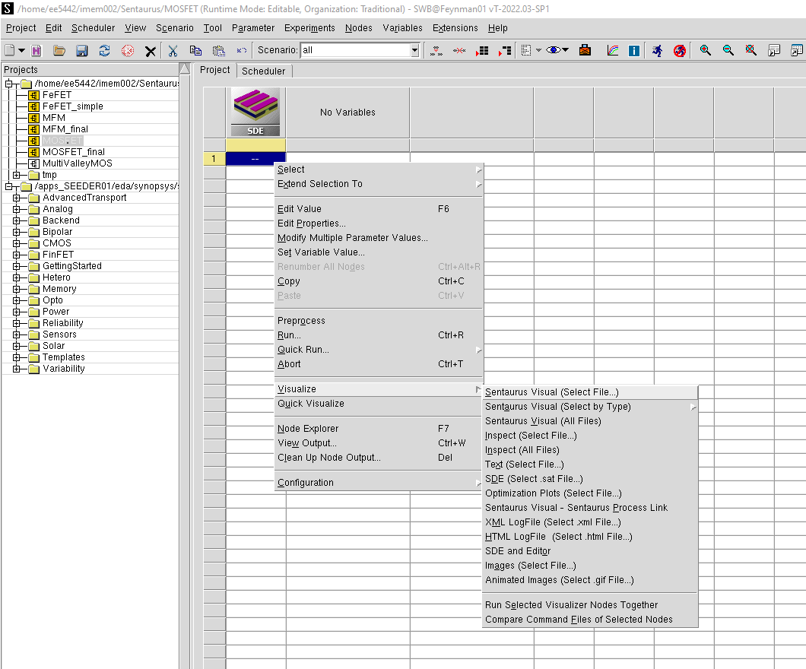
Visualize device structure
Right click the node after it turns yellow (simulation finished)

Slide 23
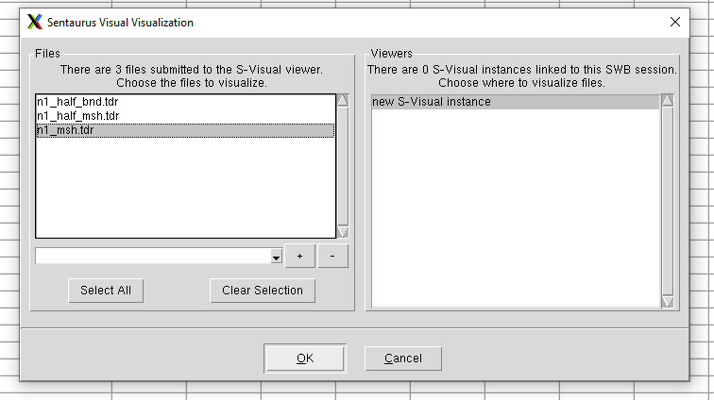
Visualize device structure
Select n1_msh.tdr for complete information
of the device

Slide 24
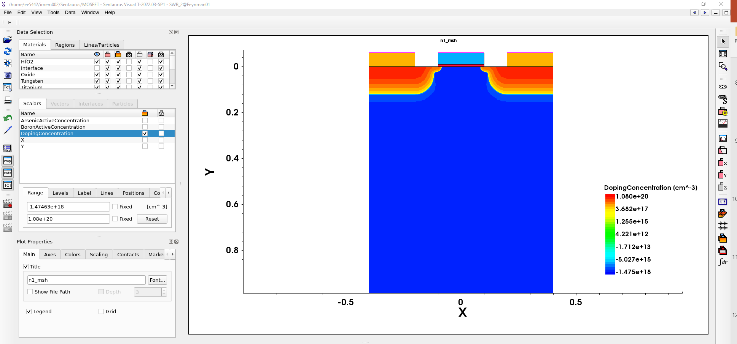
Visualize device structure
Check various parameters to display

Slide 25
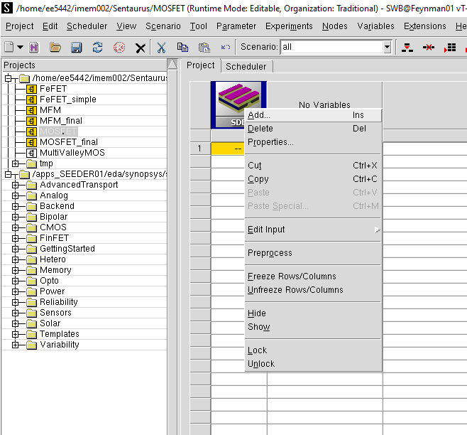
Add SDEVICE tool for electrical performance simulation
Right click SDE tool to add new tool after it

Slide 26
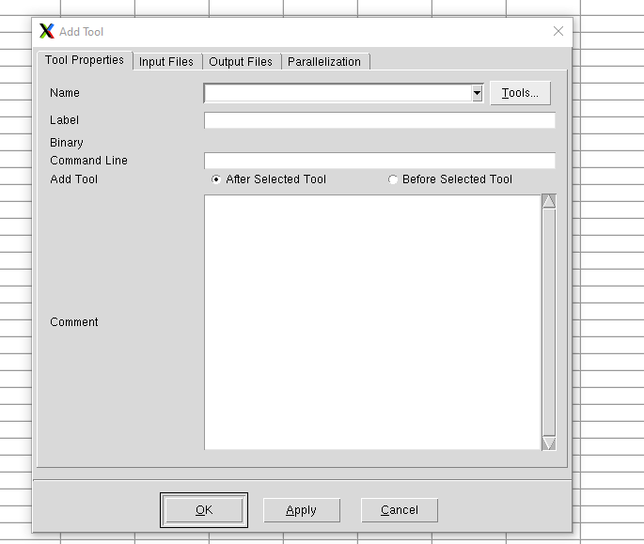
Add SDEVICE tool for electrical performance simulation

Slide 27
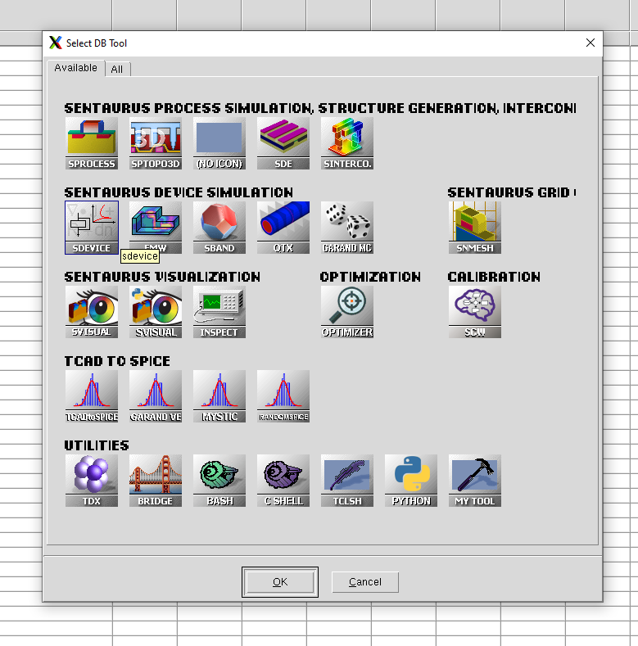
Add SDEVICE tool for electrical performance simulation

Slide 28
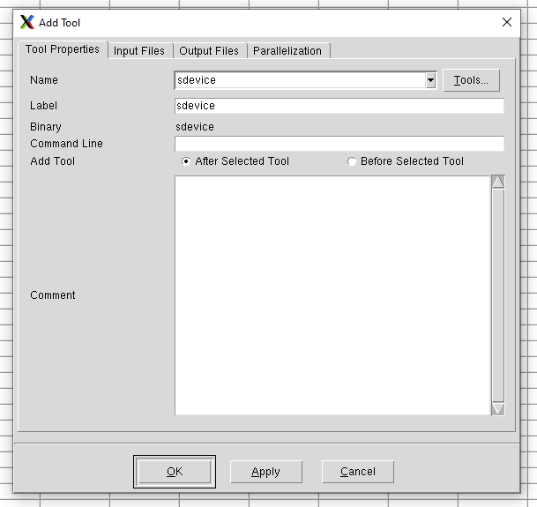
Add SDEVICE tool for electrical performance simulation

Slide 29
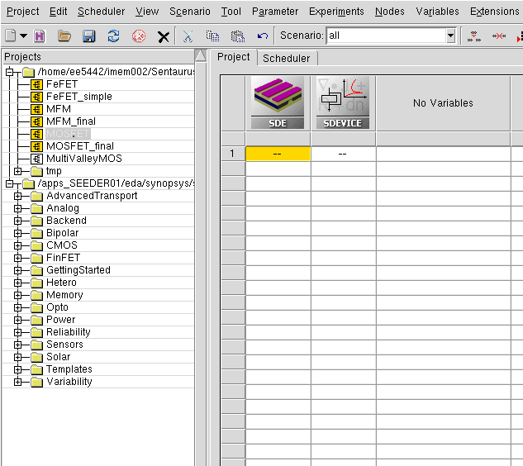
Add SDEVICE tool for electrical performance simulation

Slide 30

Edit sdevice_des.cmd for electrical simulator setup
Right click SDEVICE tool
Copy code from ‘sdevice_code.txt’

Slide 31
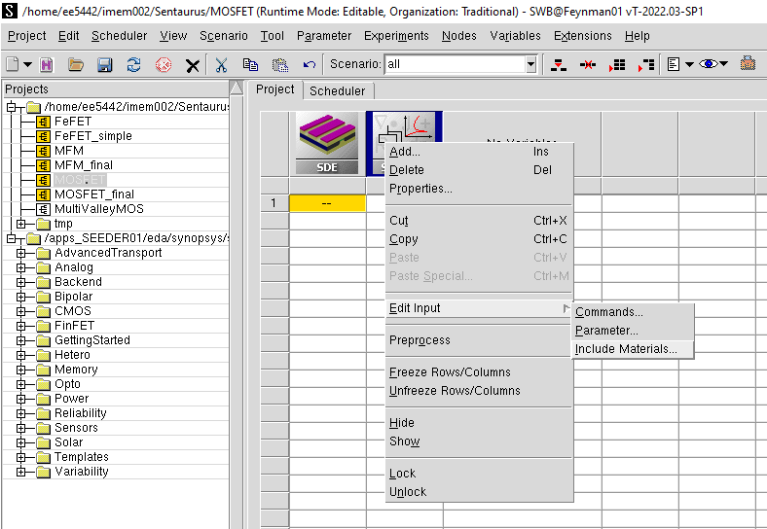
Create sdevice.par to define material parameters
Right click SDEVICE tool

Slide 32
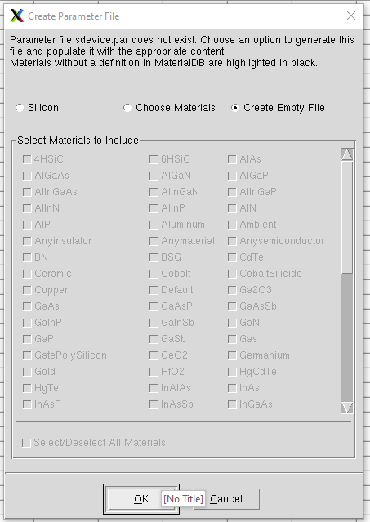
Create sdevice.par to define material parameters
Close the empty sdevice.par first

Slide 33
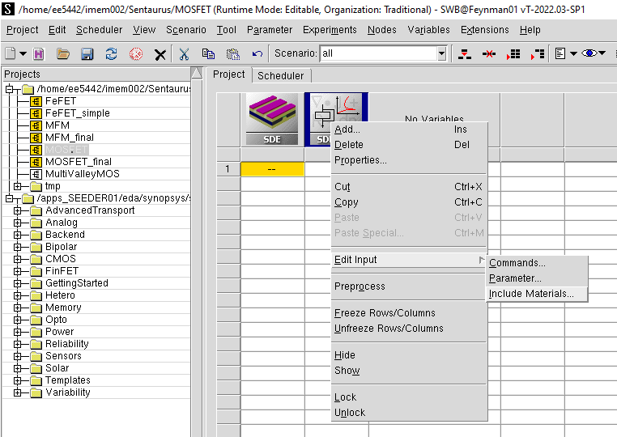
Edit sdevice.par to define material parameters
Right click SDEVICE tool
Open material selection dialog again

Slide 34
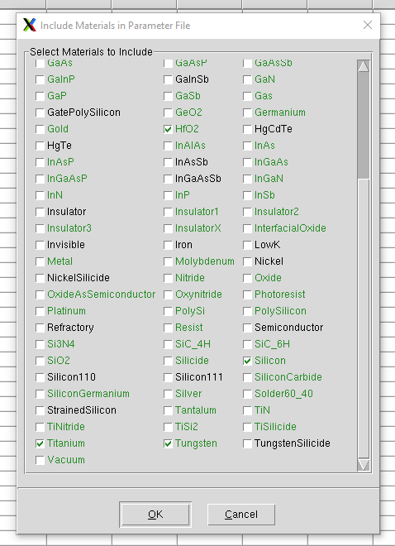
Edit sdevice.par to define material parameters
√
√
√
√
Choose the material you use

Slide 35
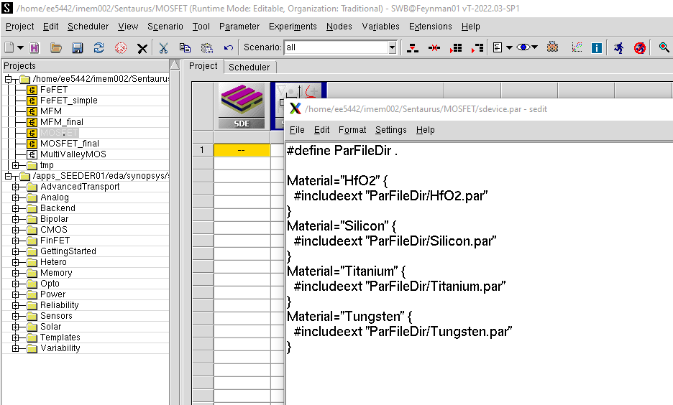
Edit sdevice.par to define material parameters
sdevice.par auto-changed

Slide 36
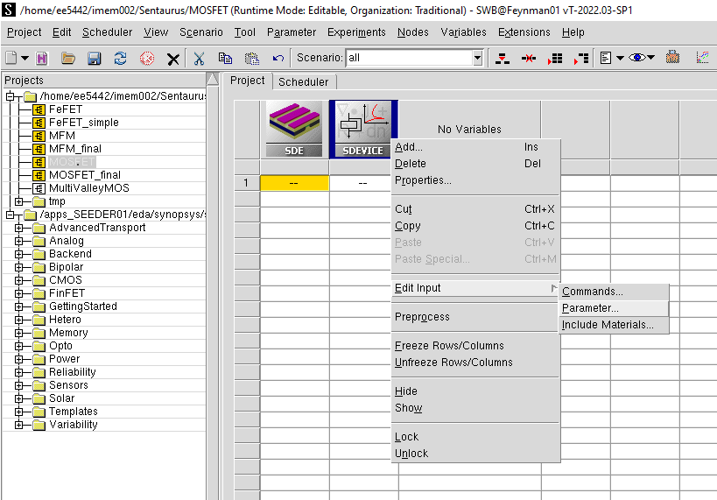
Edit sdevice.par to define material parameters
Right click SDEVICE tool
You can also open and edit sdevice.par in text file

Slide 37

Run SDEVICE tool

Slide 38
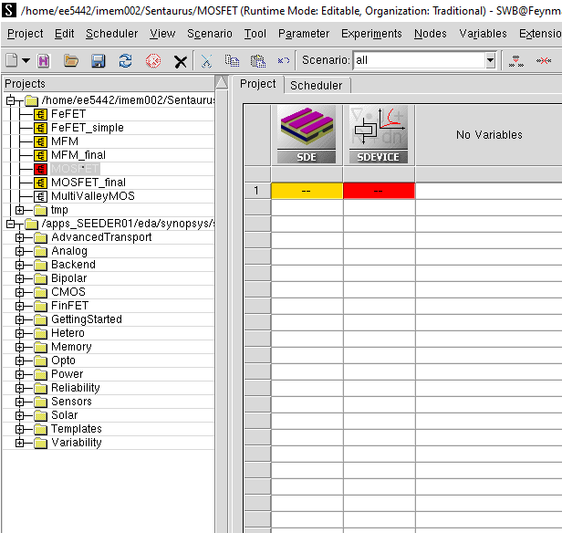
Check error message
Double click error node

Slide 39
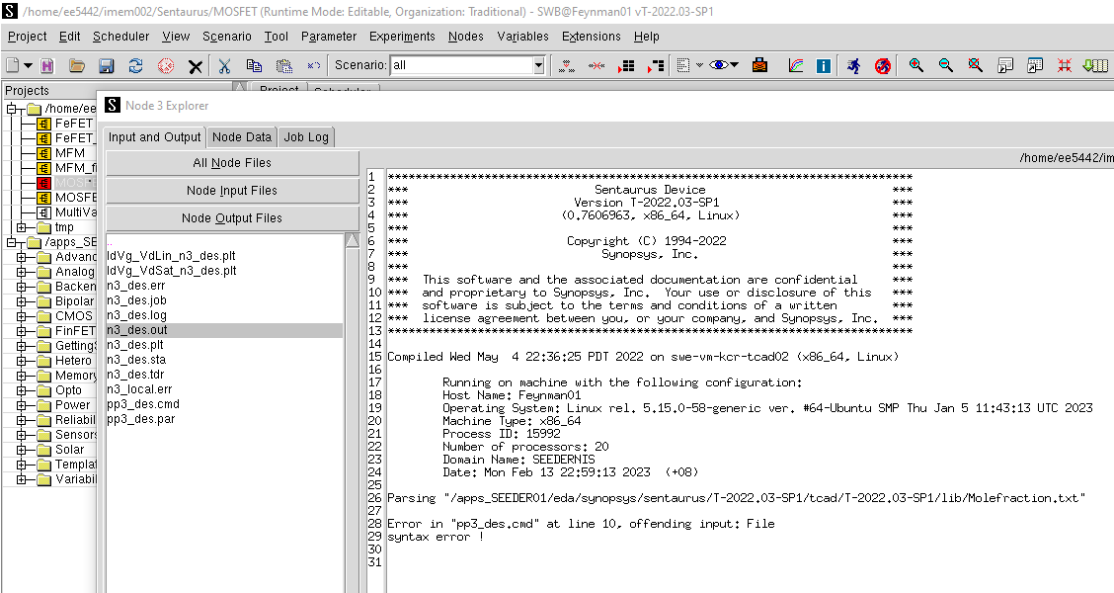
Check error message

Slide 40
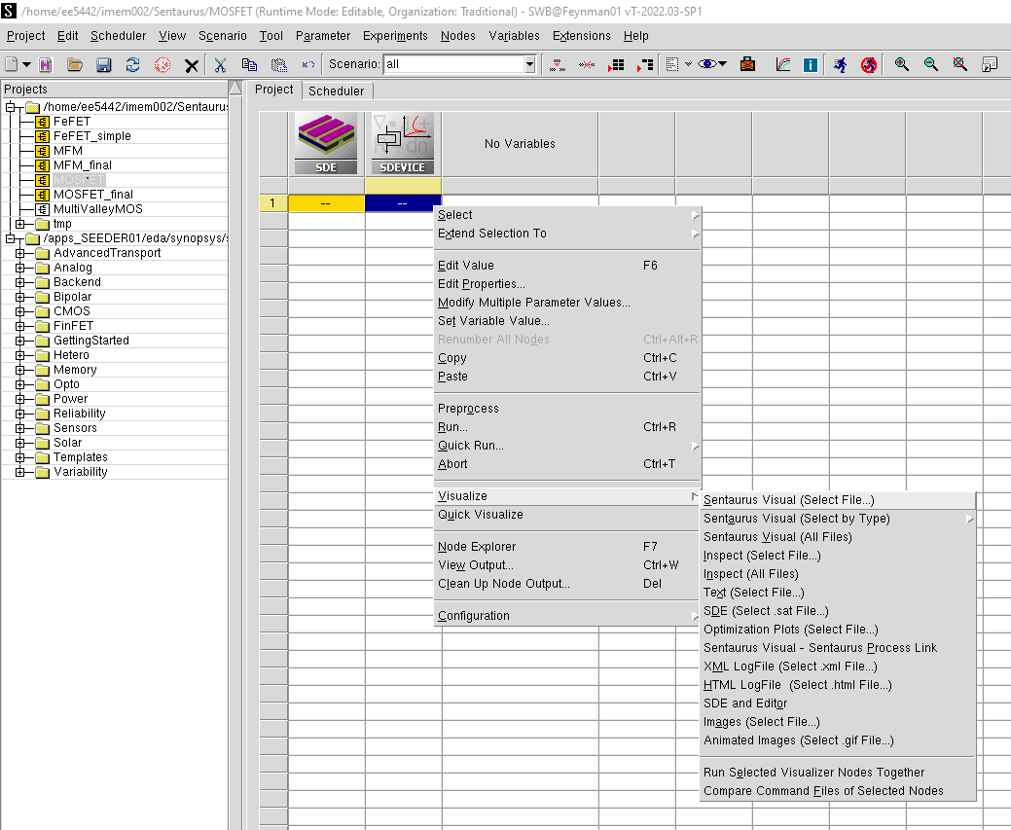
Visualize simulated electrical characteristic curves
Right click the node you run

Slide 41
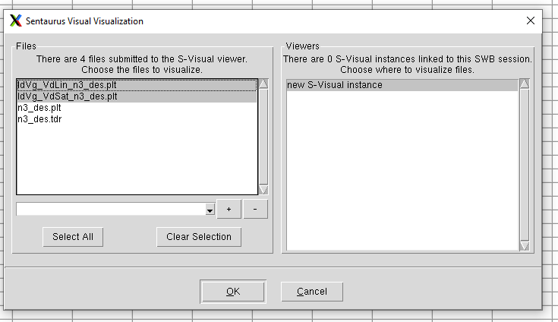
Visualize simulated electrical characteristic curves
Select .plt files to visualize the simulation results

Slide 42
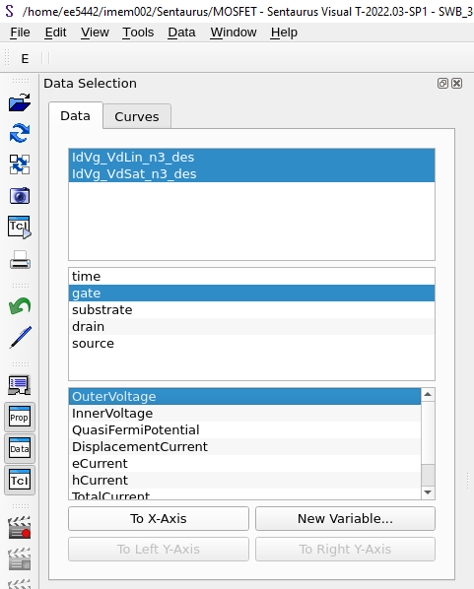
Visualize simulated electrical characteristic curves
Select V_{GS} to to be X-axis

Slide 43
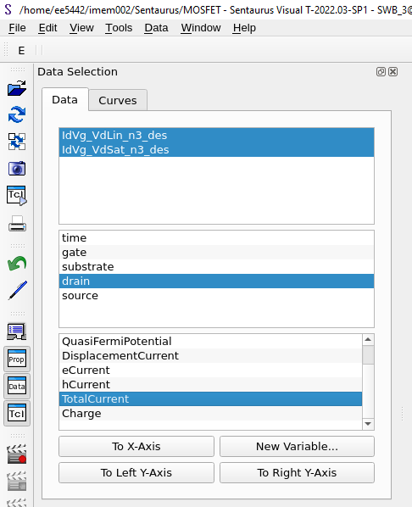
Visualize simulated electrical characteristic curves
Select I_{DS} to to be Y-axis

Slide 44
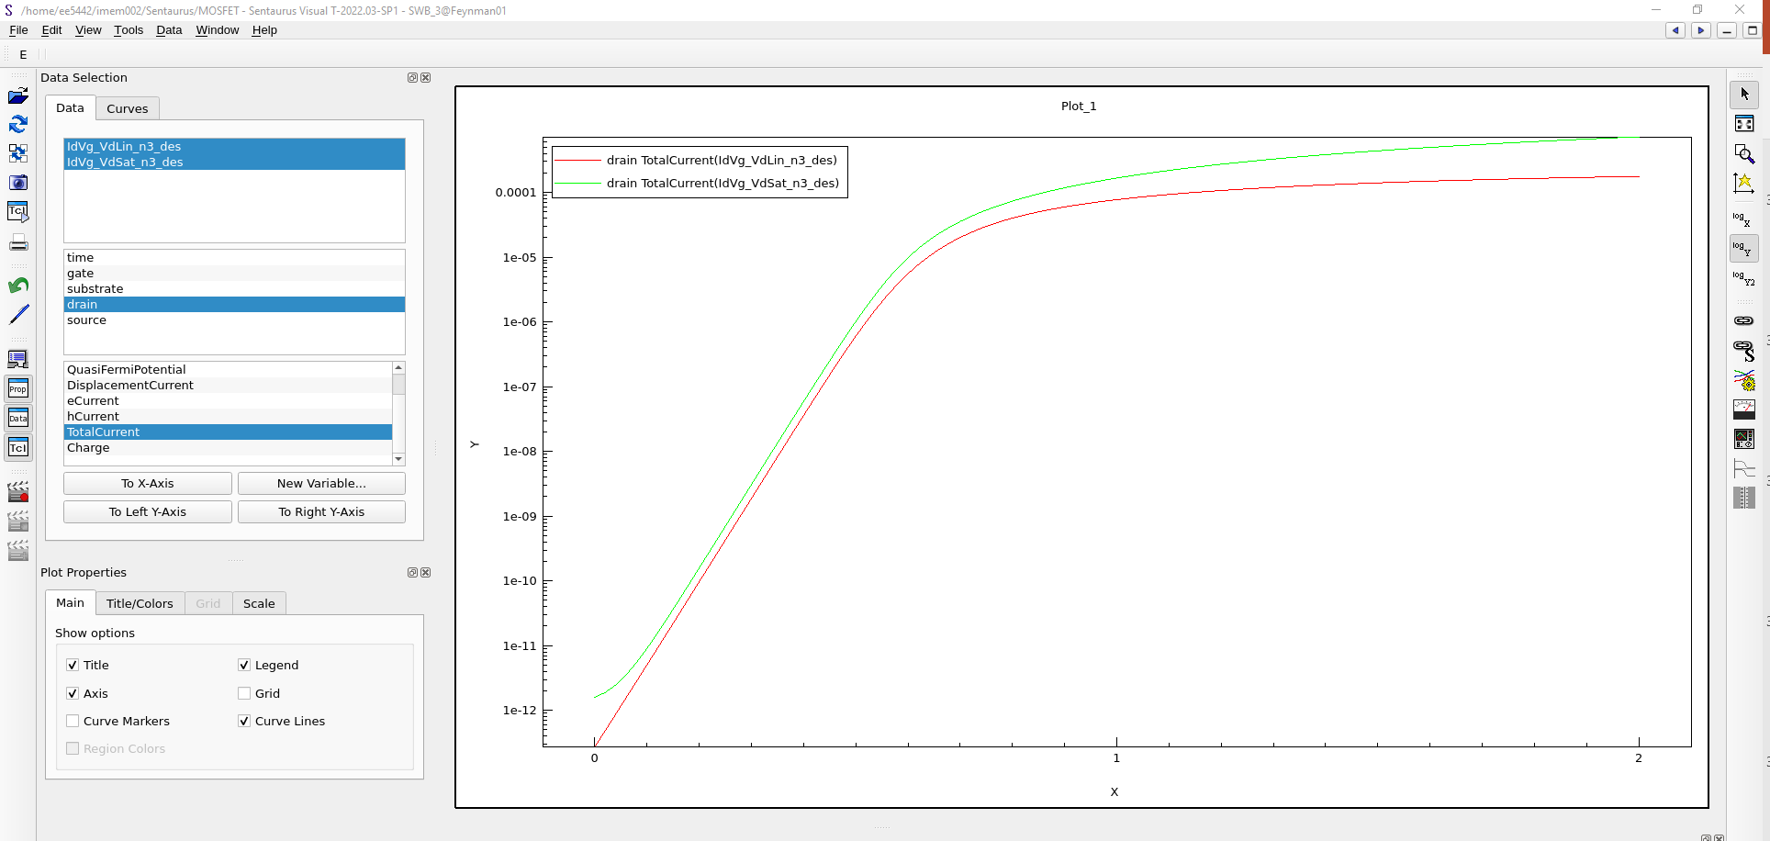
Visualize simulated electrical characteristic curves
X-LogY

Slide 45
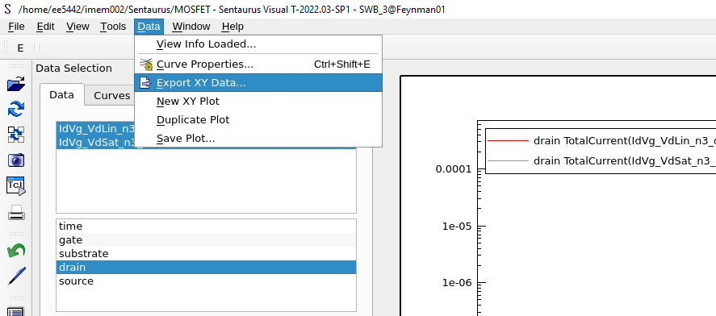
Save data to the file

Slide 46
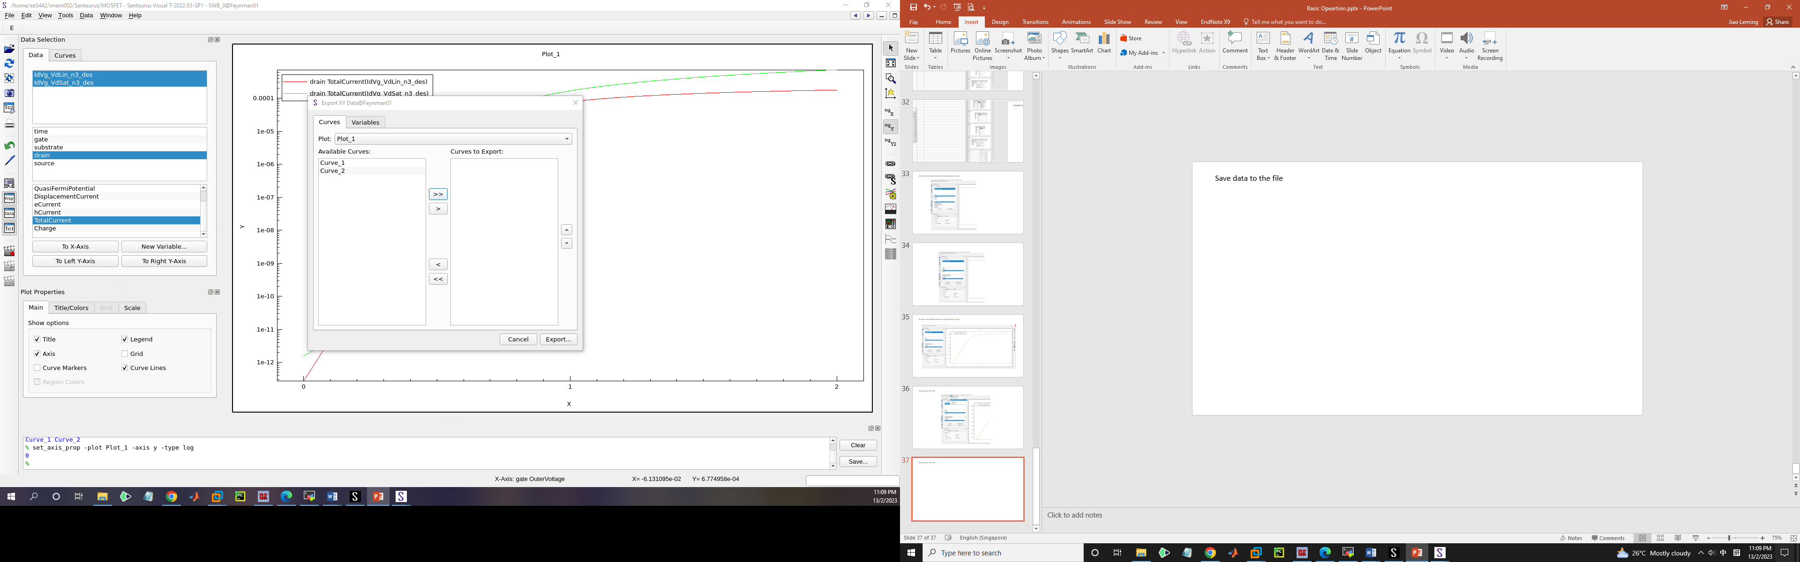
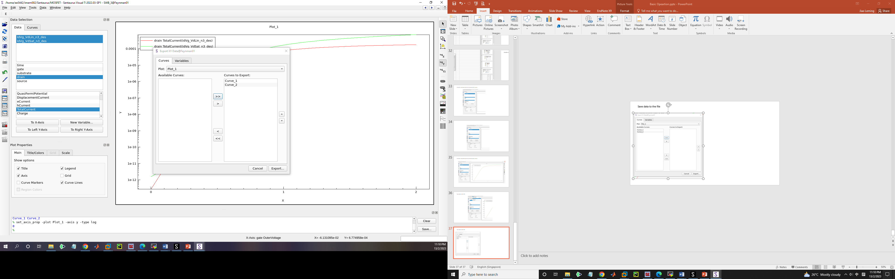
Save data to the file

Slide 47
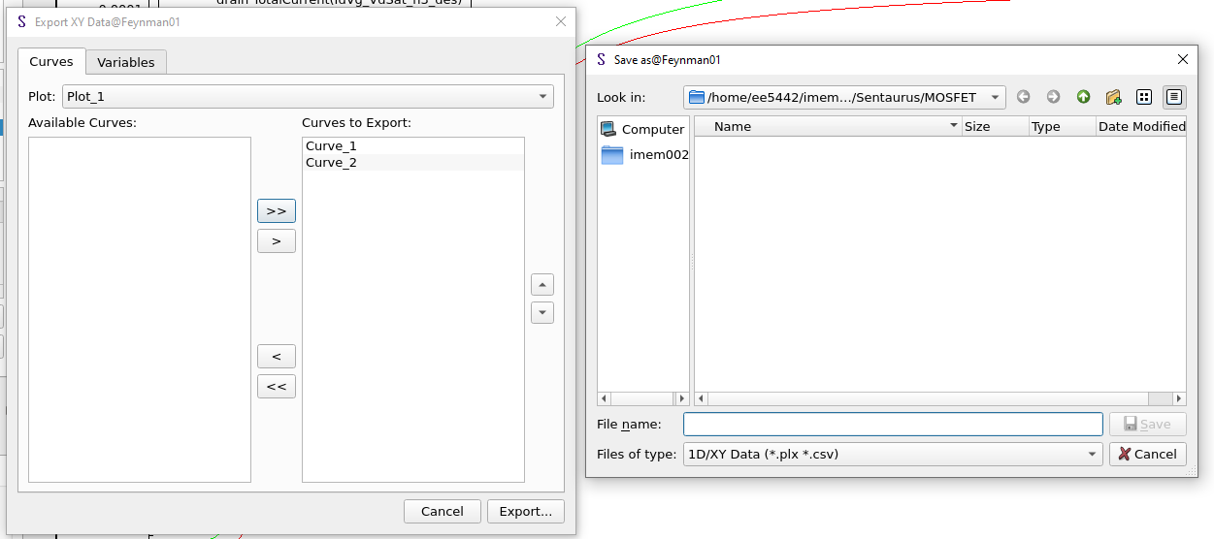
Save data to the file
Type-in the file name

Slide 48
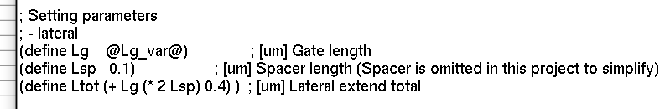
Add variables in simulation
1. Add variables in cmd file
Open sde.cmd (Refer to Edit sde.cmd for device design)
Change the Lg from fixed value to @Lg_var@

Slide 49
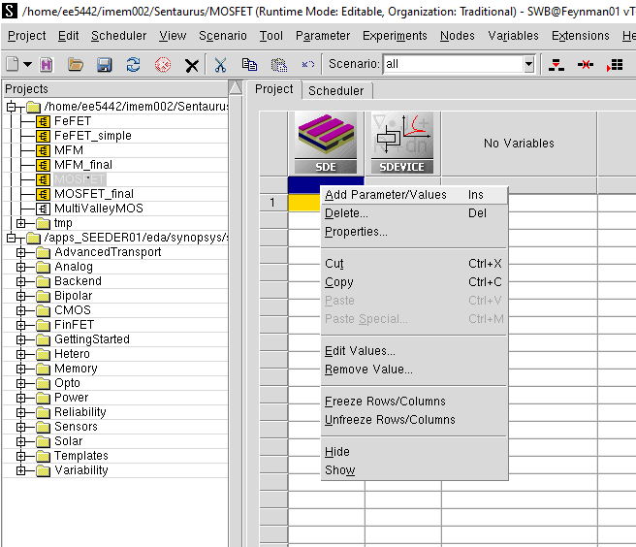
Add variables in simulation
2. Add variables in Sentaurus workbench

Slide 50

Add variables in simulation
2. Add variables in Sentaurus workbench

Slide 51

Add variables in simulation
2. Add variables in Sentaurus workbench

Slide 52

Add variables in simulation

Slide 53

Add values for variables

Slide 54

Add new materials for simulation (HZO)
Create a txt file in the project folder named as “datexcodes.txt” to state the new material.
File content:
Materials {
HZO{
code = 998
label = "Ferroelectric material"
group = Insulator
color = #dfa955
}
}

Slide 55

Add new materials for simulation (HZO)
Edit sde.cmd
Create a region with the name of the new material.

Slide 56

Add new materials for simulation (HZO)
Edit sdevice.par
Assign the new material parameters you want

Slide 57
THANK YOU

